Slide 1
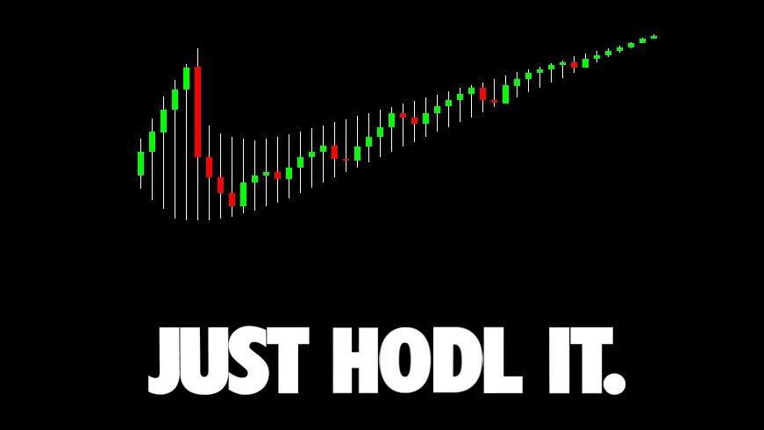
Intro to
₿itcoin & Cryptocurrency
An Educated Guess
By Sachin Meier

Slide 2
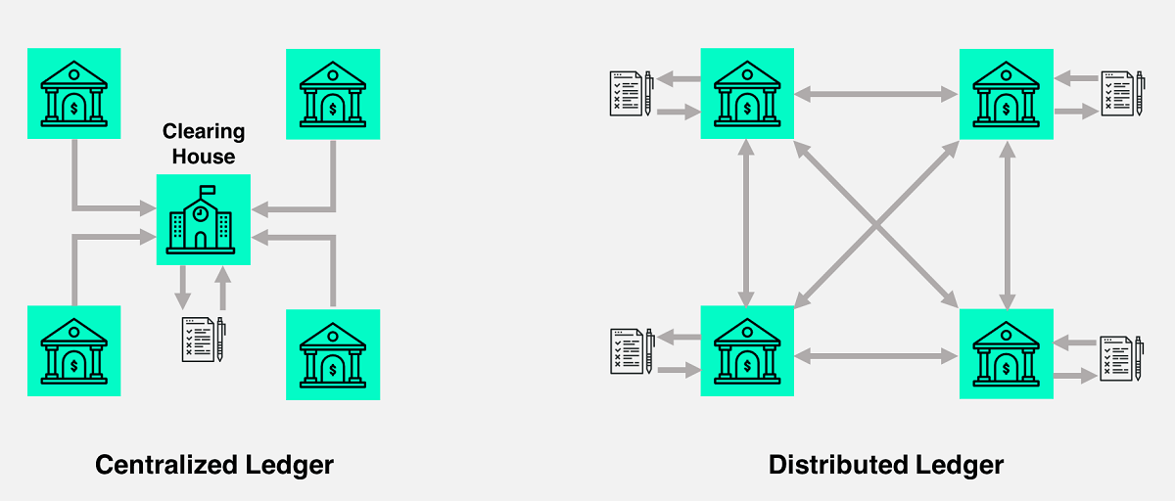
What is Bitcoin?
A Cryptocurrency
Cryptographically provable scarcity
A Public, Distributed Ledger
All transactions (TXs) are publicly broadcast on a ledger (the blockchain)
Immutable, transparent, verifiable, non-reversible
Hard Money
After 21 Million BTC (~2140), no more BTC ever.
A Decentralized, Censorship-Resistant Money
Anyone can process your TX, and unless it’s fraudulent, everyone will validate it.
Your money is never held by other people between you and the recipient.
Sovereign, Free Speech
Unlike with a bank, you literally own your money.
BTC is only code. So you’re only ever sending numbers and letters to people.

Slide 3
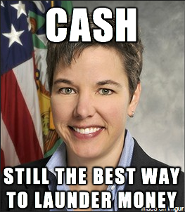
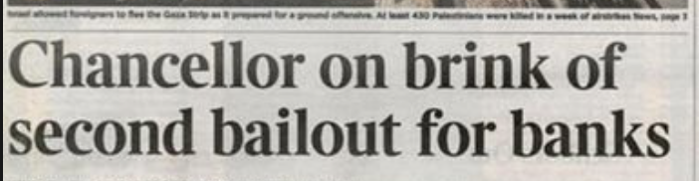
What is wrong with Fiat / Central Banking System?
Fiat: Money that is backed by Government Decree/Legal Tender Laws
Central Bank: Lender of last resort (bails out banks, prints new money)
Inflation (See: Cyprus, Venezuela, Zimbabwe)
Cantillon Effects
Disincentivizes Saving/Investment
Max Keiser: Fraud and Terrorism
Corporate Welfare
Remittances
20-35% Fees for immigrants to wire Money back home
Access: ~3 Billion unbanked people.

Slide 4
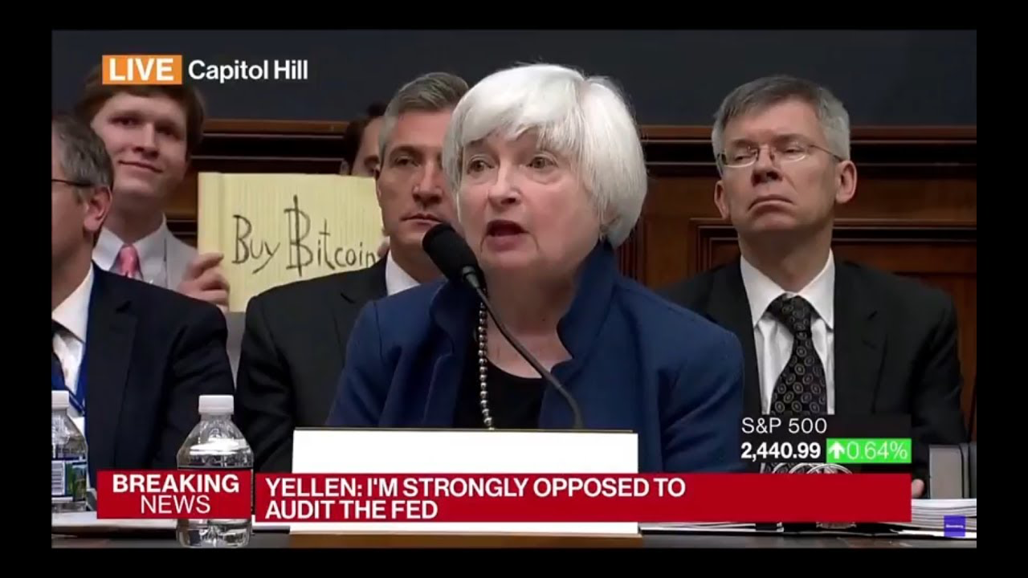

Slide 5
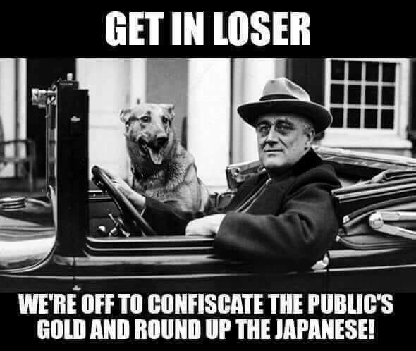
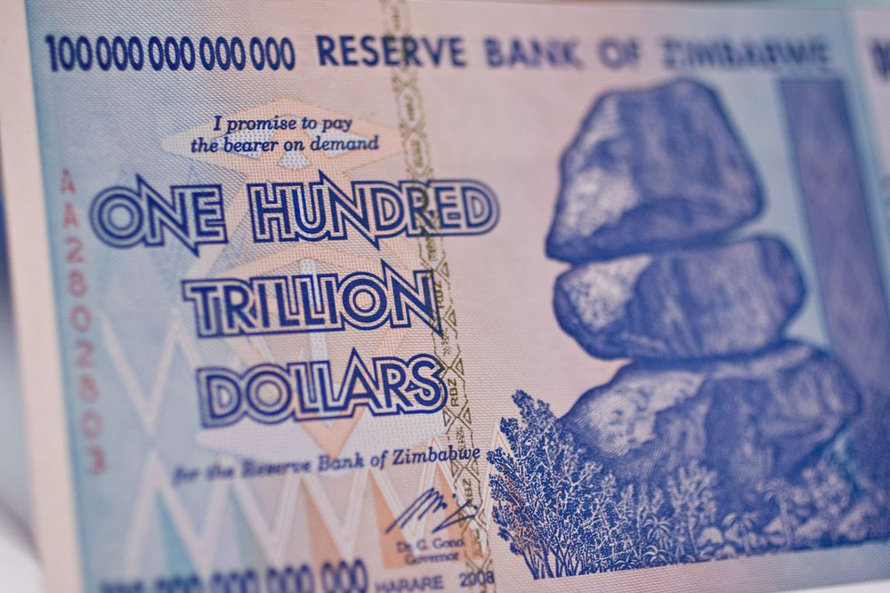
Inflation
Gold Confiscation
Nigeria: 30% per year since 2009
Argentina: 22% in 2017
Venezuela: 1,000,000% since 2012
Zimbabwe: 12,750% in 2007*
US: 56% since 1971 (Bretton-Woods)
*(The Government banned measuring Inflation.)
America, 1933: FDR makes owning gold illegal. Confiscates “all” privately held gold.
Italy, 1935: Mussolini demands gold “give-backs” (voluntarily, of course)
UK, 1966: To stop the Pound from falling, UK bans owning or Importing Gold
America, 1971: Nixon renegs on Bretton Woods and takes the world off Gold Standard (replaced by Petrodollar)

Slide 6
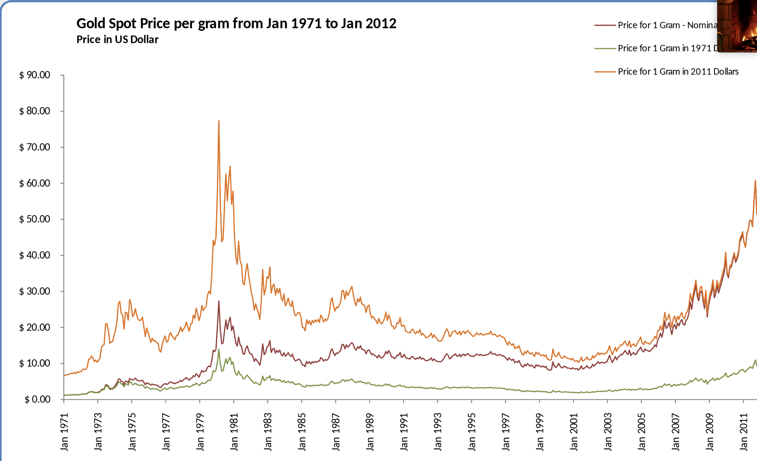
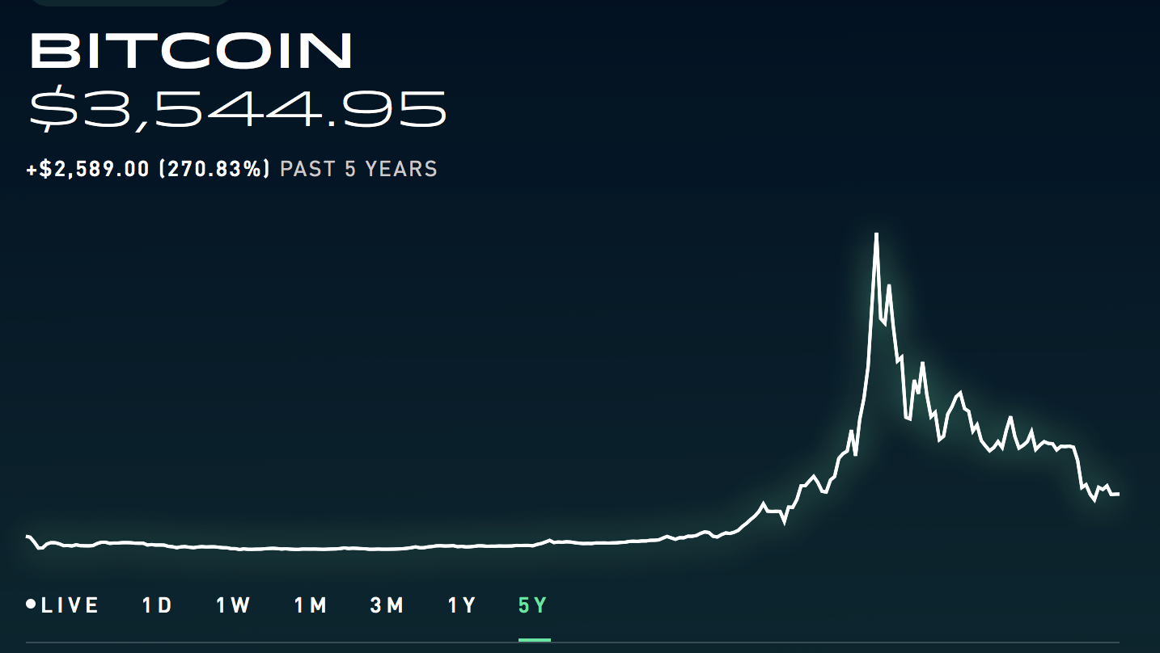
Is Bitcoin Money?
--Bitcoin is already a Store of value
(regardless of whether it’s profitable)
--Bitcoin has always been a unit of account.
Can BTC be a Medium of Exchange??
Money:
Store of value
Unit of Account
Medium of Exchange
Moon
$20,000

Slide 7
Can BTC be a Medium of Exchange?
Blockchain technology is extremely inefficient, slow, and data-heavy. Scalability is also a huge problem. If 7 Billion people wanted to use BTC right now, the Network would stall out or TX Fees would skyrocket.
BTC: 7-10 TPS
PayPal: 200 TPS
VISA: 24,000+ TPS
Solution? ⚡ Lightning Network. ⚡

Slide 8
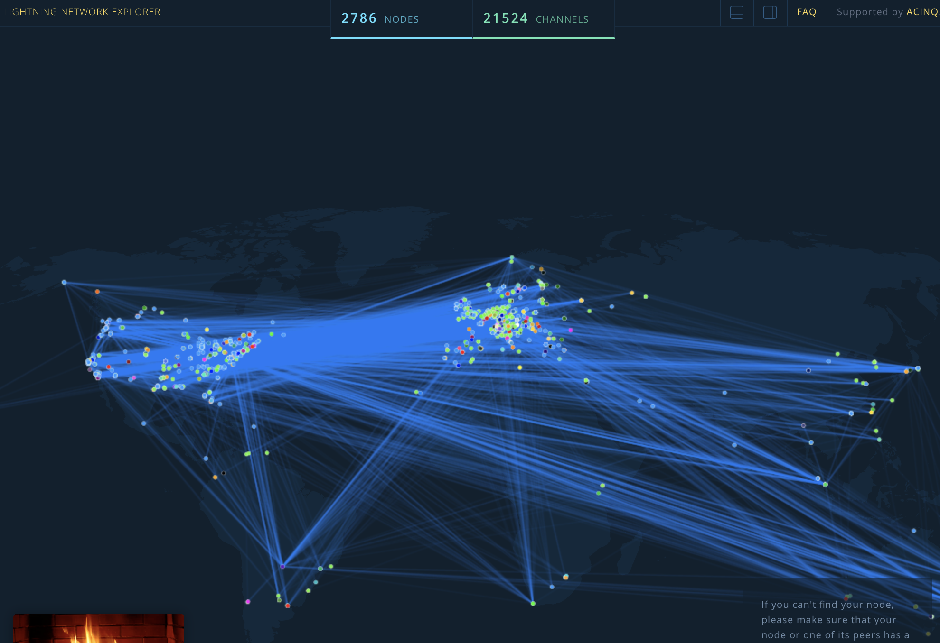
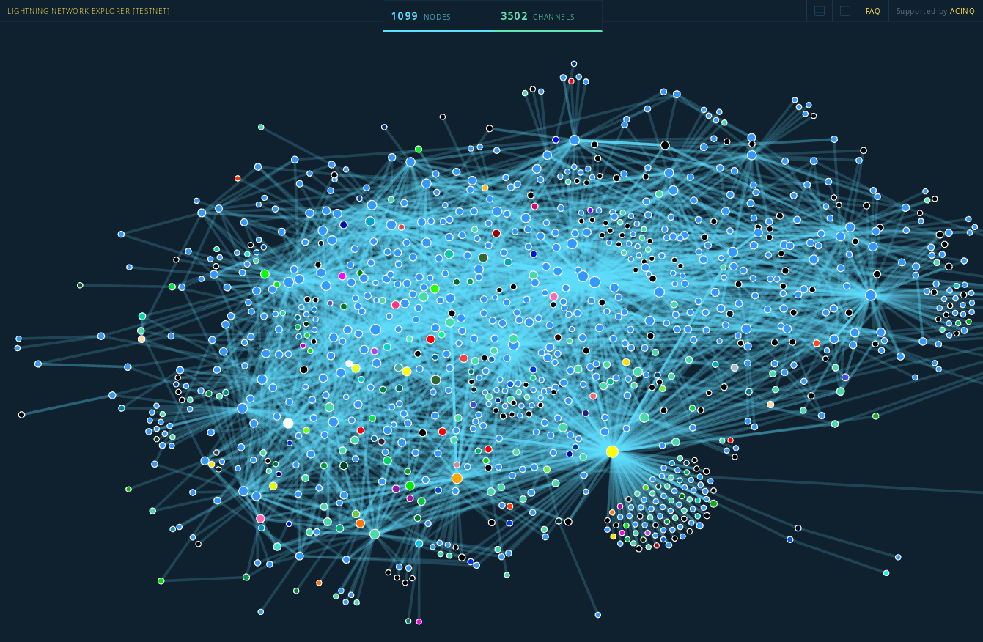
⚡ Lightning Network ⚡
Simply: A direct P2P payment system.
⚡ Truly Instant Payment
⚡ Trustless, computer-executed contracts
⚡ Infinitesimally small amounts
⚡ Even smaller fees. ~$.00001 per TX
⚡ Infinite TPS Potential
Visualization of the LN
2018: 1000 Nodes - 3500 Channels
2019: 5000 Nodes - 23000 Channels

Slide 9
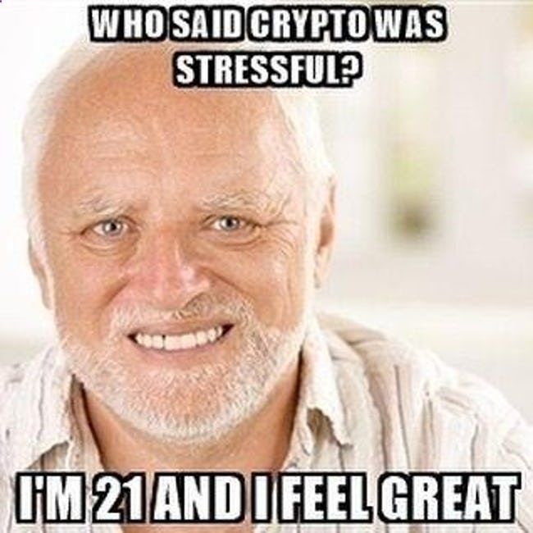
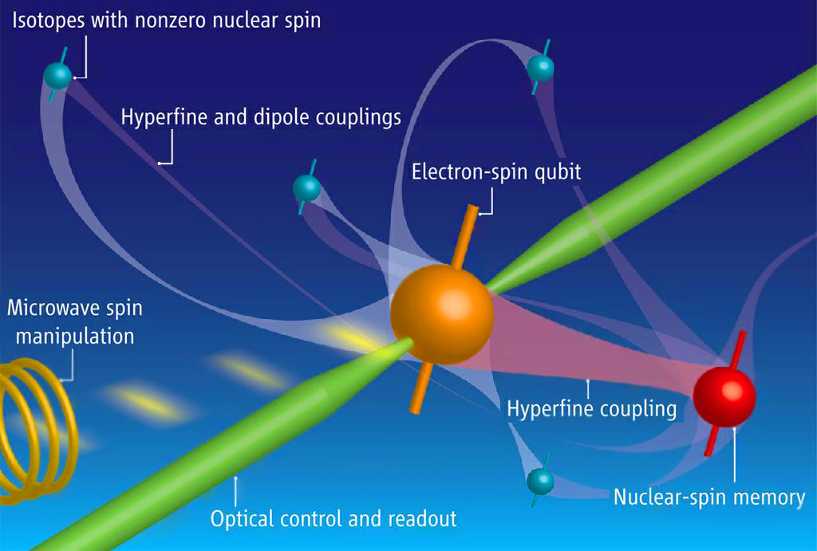
Is BTC a Scam / Will it go to Zero
Blockchain not Bitcoin
The Fiat Argument: BTC’s based on nothing.
The MySpace Accusation.
Deflation will impoverish people.
The Government will shut it down.
Warren Buffet Says so.
It’s Money for Criminals and Terrorists
Quantum Computers?!?!?

Slide 10
More Resources
Bitcoin Resource List by Jameson Lopp
Bitcoin WhitePaper by Satoshi Nakamoto
Lightning WhitePaper by Joseph Poon and Thaddeus Dryja
Congressional hearing on Bitcoin 2013
Bitcoin Explained to Canadian Parliament by Andreas Antonopoulos
Twitter, Reddit, Slack, Email Lists. (For suggestions follow @mountgox101 or ask me)
Debate: Will Bitcoin Stay?
Erik Voorhees vs. Peter Schiff
Podcast: Noded with Pierre Rochard and Bitstein AKA Michael Goldstein
Podcast: Tales from the Crypt with Marty Bent
Books:
The Bitcoin Standard by Saifedean Ammous
Mastering Bitcoin by Andreas Antonopoulos

Slide 11
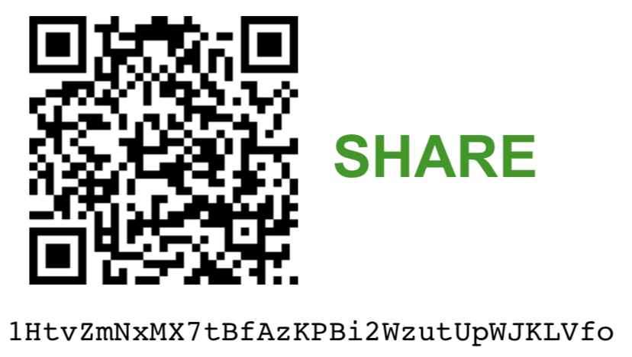
Never buy Altcoins, ICOs, etc.
Never sell Bitcoin (HODL)
Don’t use bitcoin.com
Own your own Private Keys
Run a Full Node
Don’t Pay Taxes
Don’t trust, Verify
Don’t trust Ver
Read Bitcoin Twitter
Read certain Reddits
Read A History of Money and Banking in the US
Ask for Help, esp. on Twitter and Slack
Don’t look at the price
Backup your keys
Have a “will”
Tell your Friends
THANK YOU! Email me (spm116@georgetown.edu) with any questions about anything.
More PowerPoints here
(https://drive.google.com/drive/folders/1AgMsxIlvEb8Vnymy5mJ5Cy8Djh6IeNKP?usp=sharing)

